Slide 1
The Economics of US Health Care
New Canaan Investment Club
February 7, 2018

Slide 2
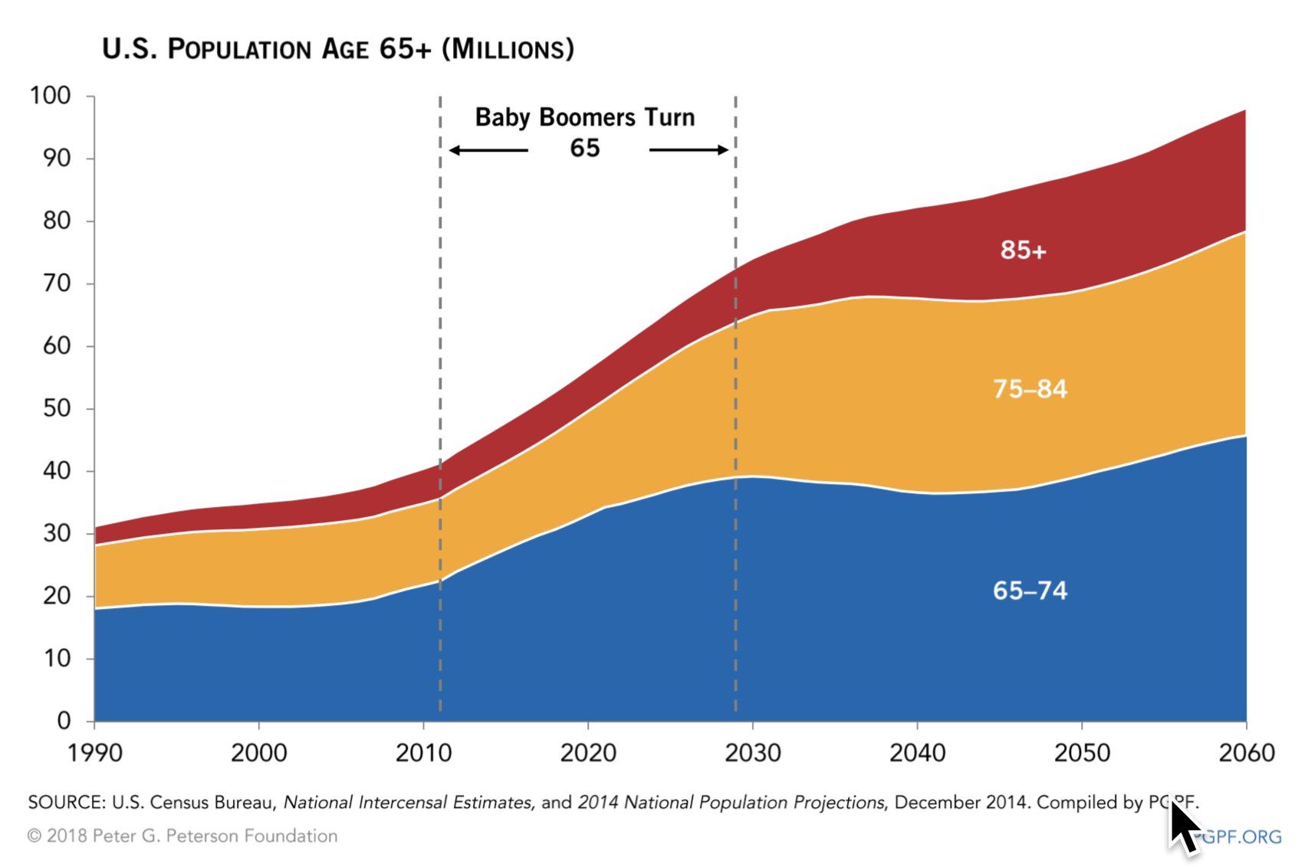
Health Care Economics is Driven by Increased Aging

Slide 3
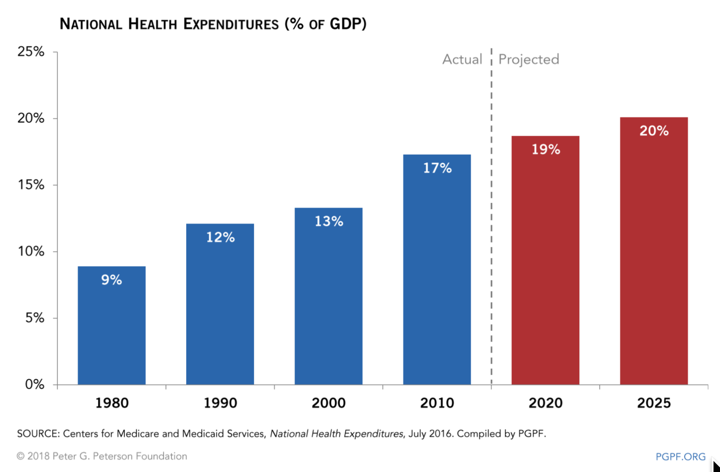
Health Expenditures Will Equal 20% of GDP

Slide 4
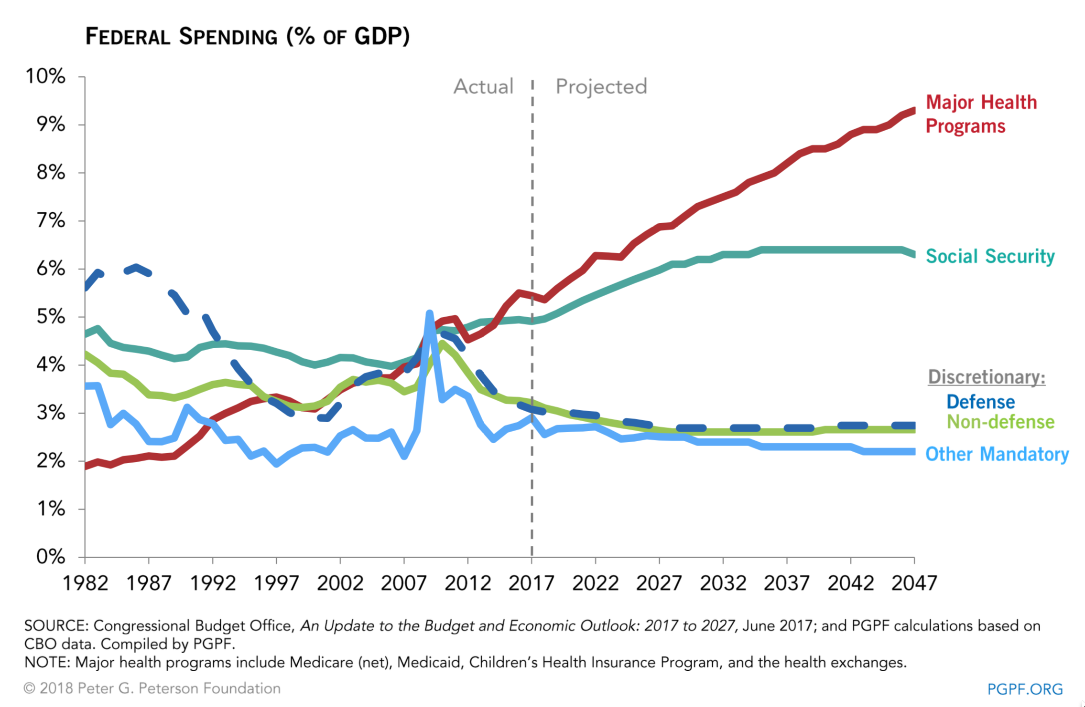
Federal Health and Welfare Spending Will Dominate Spending

Slide 5
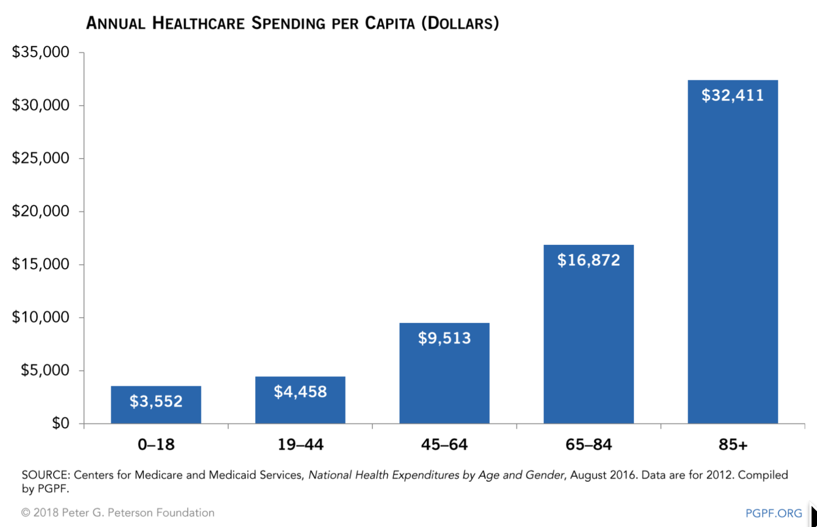
Health Spending Now Escalates With Age and Inflation

Slide 6
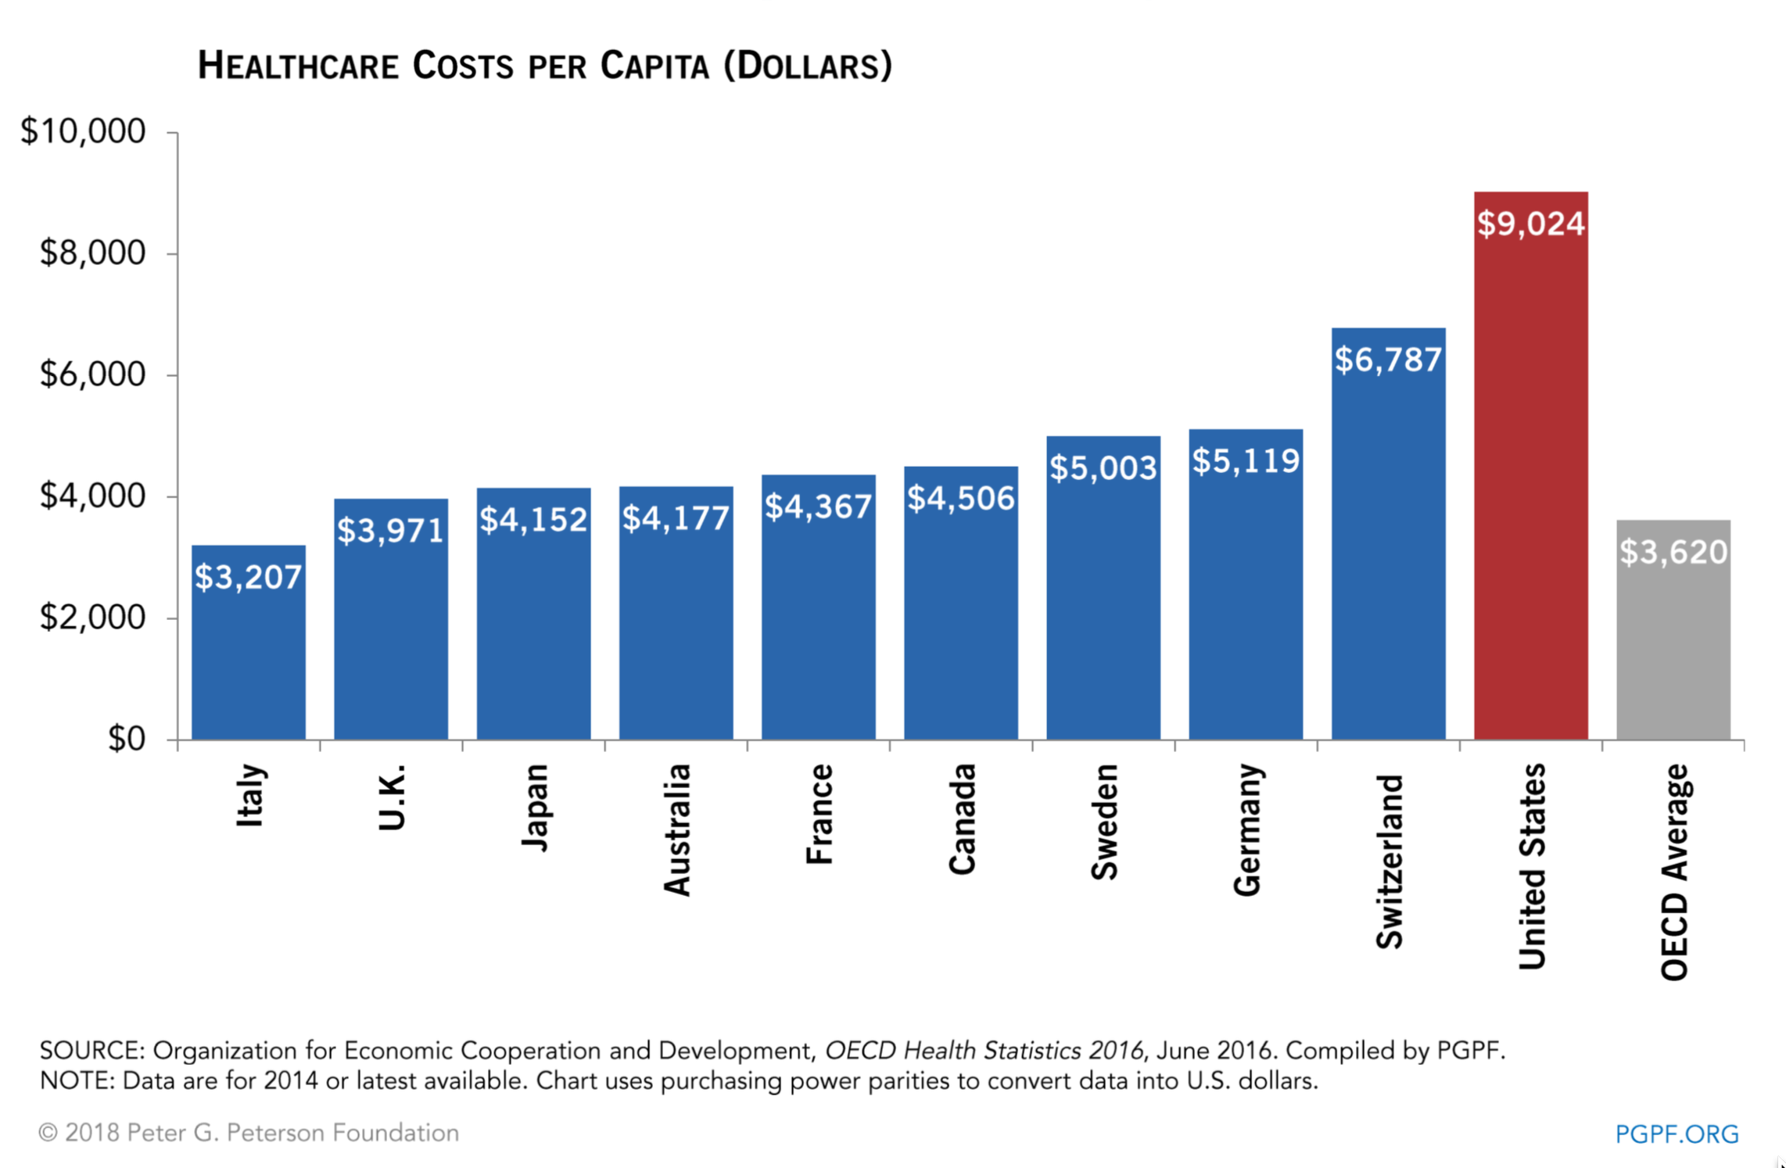
US Health Spendinig Exceeds Others but is Insufficient

Slide 7
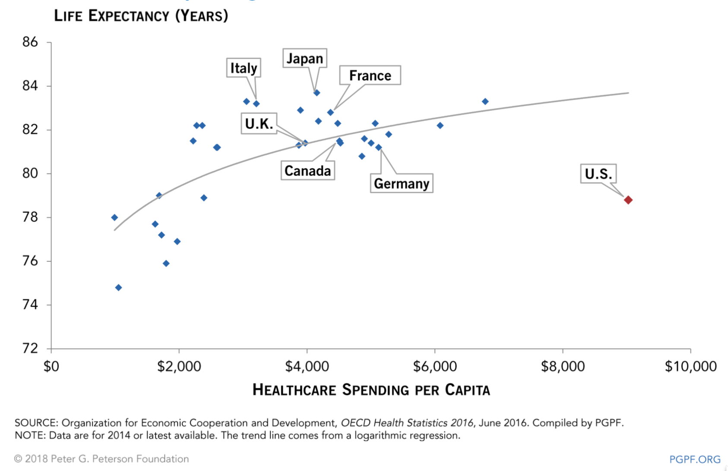
US Health Expenditures Are Inrelated to Life Expectancy

Slide 8
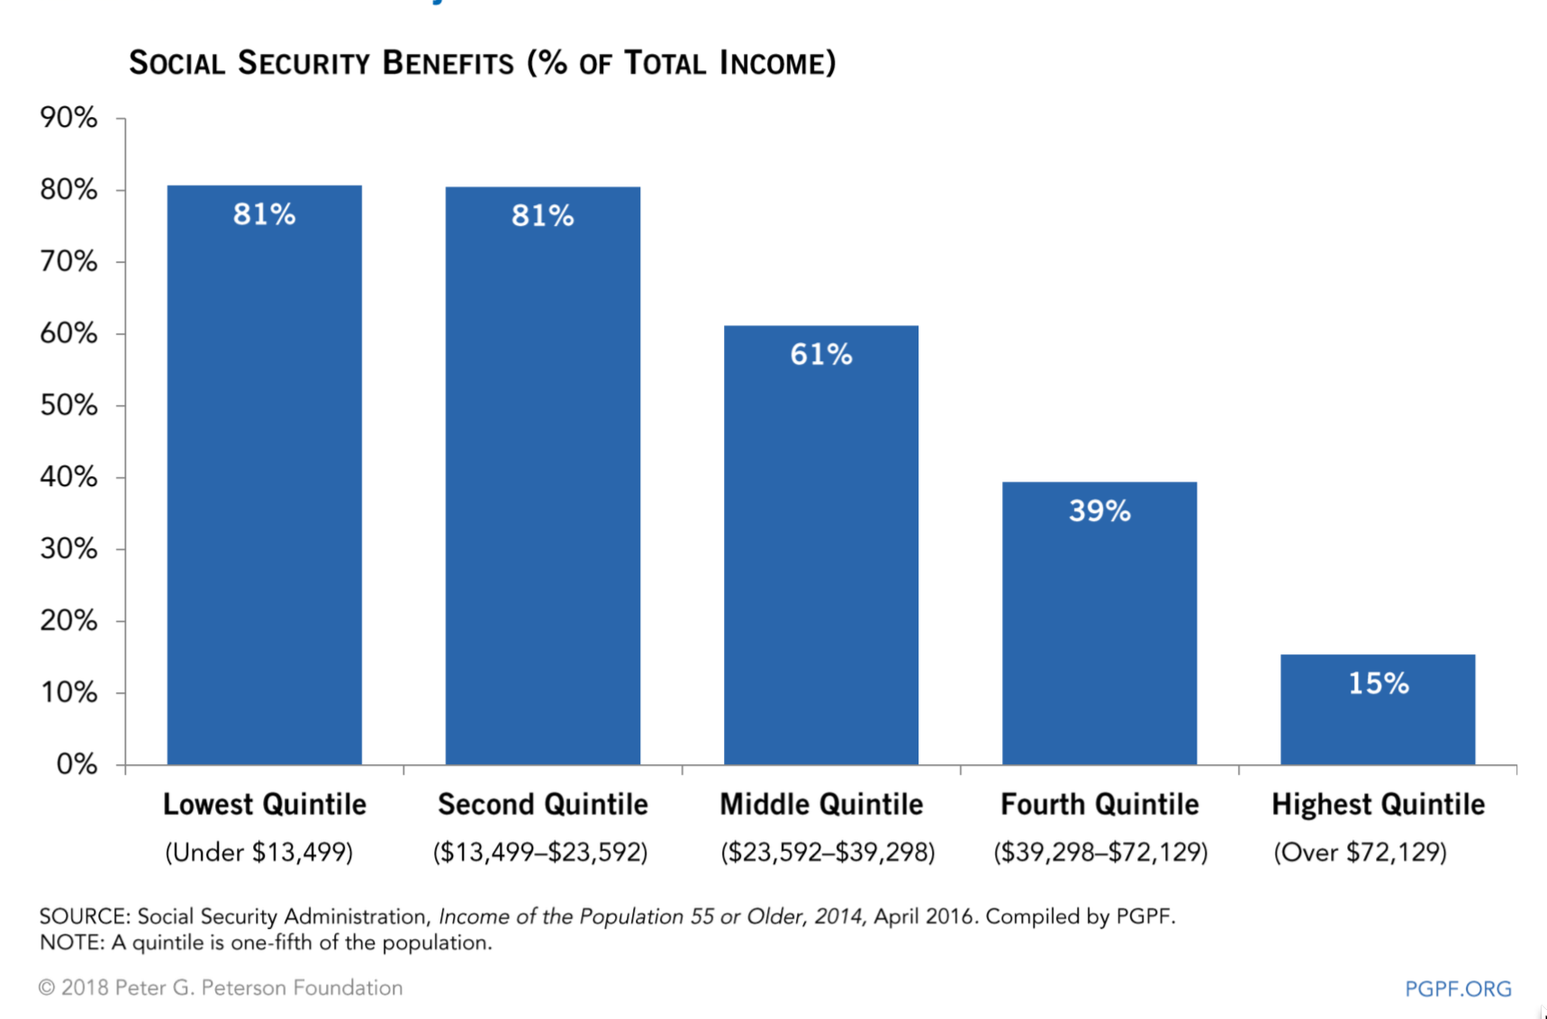
Over 60% of Population Now Depends on Social Security

Slide 9
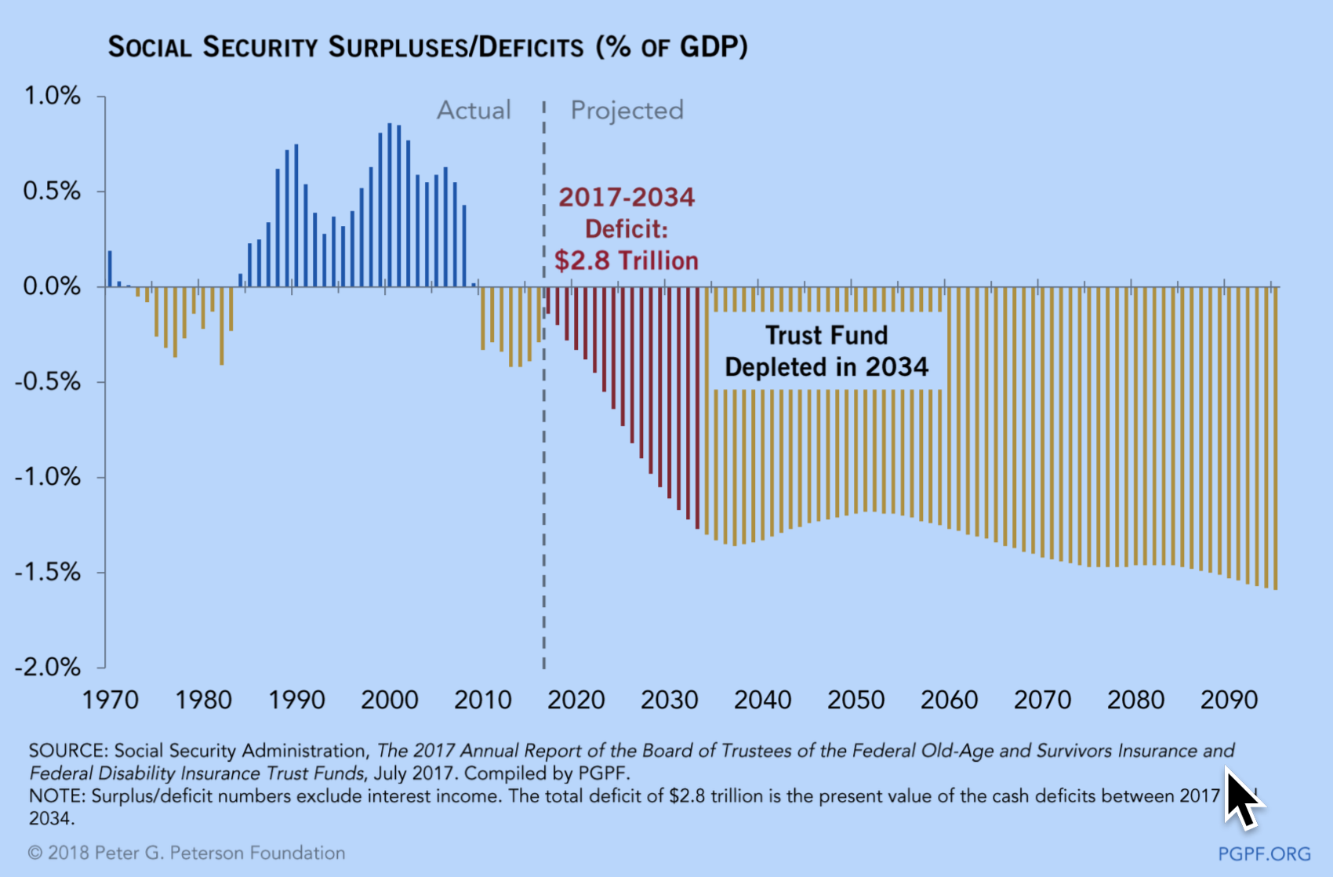
Social Security Will be Actuarially Bankruupt by 2034

Slide 10
Conclusions
Improving the health of an aging population becomes top US priority.

